Slide 1


Solution By: IMAGE SKELETONS
PSID: INTL-IVA-10
Team Leader Name : Kanugula Ramya sri

Slide 2

Idea Introduction
EVENT DETECTION IN CCTV FOOTAGE
Tech Stack
1.Scene detection
2.Recording time
3.Recording frame number.
Resources Used
1. link. springer
2. Articles on event detection
3.Manthan description
Any Third Party API/Services used
Yes
No
CRIME DETECTION WITH LESS TIME
Automatic analysis of CCTV footage to detect events and recording the timestamp and frame number to help in crime investigation.

Slide 3

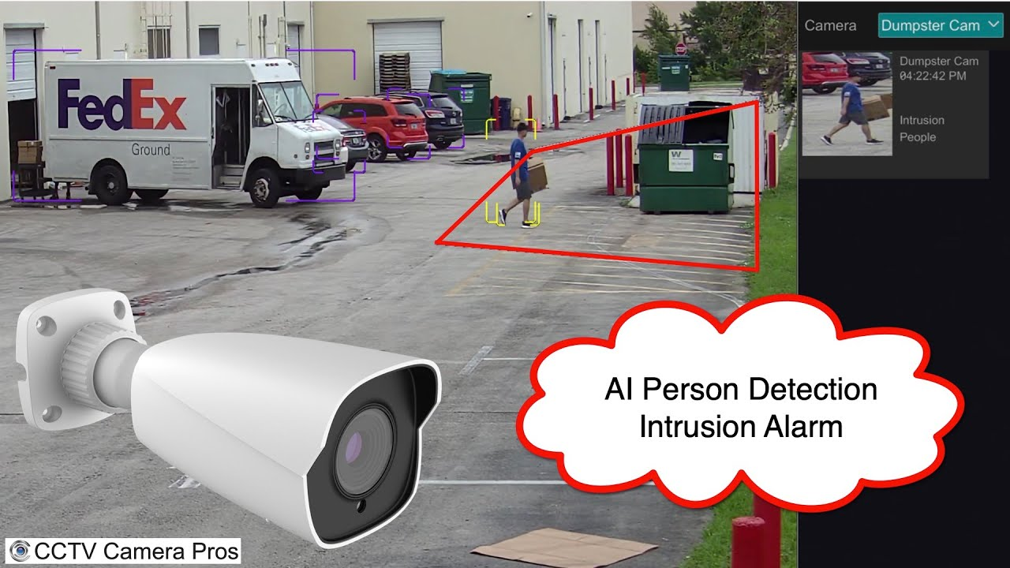
Our Approach Towards Idea
These days we are seeing many accidents related to chain snatching and knife attacks and even national wide crimes like bomb attacks. This made us to find a convenient way to find the event in CCTV footage without taking much time and effort.
We added a feature that makes an alarm sound if it finds any event that is related to knife attacks or chain snatching to make people alert.
There are various sample data to take help for building the solution for problem statement i.e., event detection in CCTV footage.
Notes:
Use any image of your proposed solution here instead of this macbook image

Slide 4

Team Slide
K. Ramya sri
In this presentation, the coding part for the problem statement is done
M.Madhusha
The code built for the problem statement is checked for the bugs in it and add features for it.
K.Srija
The code is corrected and used test cases and sample data to check the performance.
K.Nikitha
The information and sample datas for the problem statement is gathered.
K. Tejaswi
The presentation for the project is prepared from the information and the code that is built.

Slide 5
Development Pipeline
Proposed Development Plan in pointers
1.Getting information from the real world problems.
2.Analysing the problem.
3. Checking the possible ways to solve the problem
4.Building the project.
5.Making a presentable format of solution.
Documents To be prepared for installation and evaluation
1 visual studio
2 .NET
Any Third party API used, if yes please specify
No, we did not use any API.
Repository Link or Any refrences link of folders
https://github.com/ramyasri2001/event-detection-in-cctv-footage
Proposed UI and functional flow in pointers
1.Recording
2.Sensing
3.Identification
4.Recording Time
5.Alerts the scene.
Step A
Step B
Step C
Step D
Step E

Slide 6
Vision of idea
Our idea was developed by observing the scenes happening around us. The code was built in such a way that the situation might get alerted for people for any kind of rescue instantly.
Our idea is unique for the feature we added which can alert surrounding people by that the victims can get help instantly and crime record might decrease.
At this instant of time, we have built only the code and tested through the data sets. It is needed to get finalized as a product within a few weeks.
In the early stage of building the idea we came up with a solution that could help the victims instantly through alarms.

